Slide 1
Attracting Talent
Session 4/10

Slide 2
Session Outline
What to people want from work and career?
How can organizations communicate who they are and what they have to offer?
  Employee Value Proposition
  Employer Branding
Key recruitment decisons

Slide 3
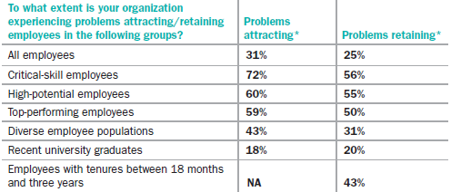
Attracting talent is a key concern for companies
Source: 2012-2013 TW Global Talent Management and Rewards Survey

Slide 4
Companies who are successful in attracting talent…
Understand what people want from work and career
Communicate who they are to current and prospective employees
Translate their EVP into a strong employer brand
Invest in recruitment
(Are selective in hiring – Topic for next week)

Slide 5
Understanding what people want from work and career
Schein’s MIT research
People were followed for about 10-12 years;
Asked about the reasons why they chose particular jobs/moved organizations
Patterns emerged from the findings

Slide 6
Understanding what people want from their work and career - Career Anchors
Anchor | Preference for…
Autonomy | Working in environments where one does not feel bounded by other people’s rules and norms.
Entrepreneurial Creativity | Developing one’s business, a new product or service.
General Managerial Competence | Career progression; high income; integrating the efforts of others; ultimately become a general manager
Life Style | Work-life balance.
Pure Challenge | Face extremely difficult problems; compete against others
Service/ Dedication to a Cause | Performing work that makes a significant contribution to others and society
Security | Employment stability and financial security.
Technical-functional | Developing and applying professional skills and abilities.

Slide 7
Understanding what people want from their work and career
Complete the Career Orientations Inventory.
You can find the file attached to this video with instructions on scoring.
After scoring access poll everywhere and enter your dominant orientation.

